Slide 1
Automatically classify consumer goods
ALI JAFFAR
20/04/2022

Slide 2

Overview and context
01

Slide 3

problematic
Context: “Place de marché” company company, which wishes to launch an e-commerce marketplace.
Converting to categorised Manuelle the Attribution into Automatic Attribution
Mission
Perform a first efficiency study of the classification engine
dataset analyzer
perform pre-processing of product images and descriptions
dimension reduction
clustering
Notes:
Modifie le contex a partir de open class room

Slide 4
Analyse
exploratory data analysis
Text data processing
preparation of the corpus
corpus processing
size reduction
classification
image processing
Pretreatment
determination of explanatory variables
Classification
convolutional neural network
CNN
Keras VGG16
Conclusion
Plan

Slide 5
Data Presentation
02

Slide 6
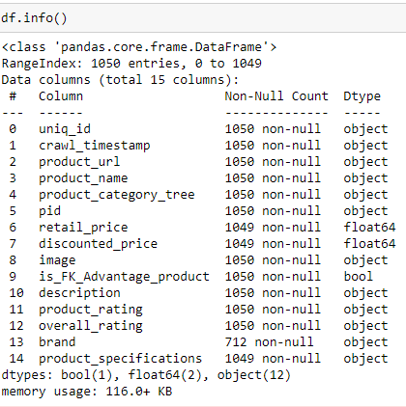
Description
Data Presentation
Fichier | Key | Nbr of lines
Image | Folder | 1050
Customers | flipkart_com-ecommerce_sample_1050 | 1050: 15

Slide 7
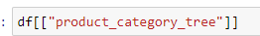
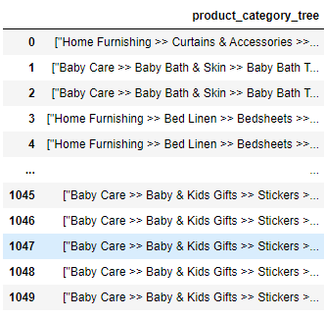
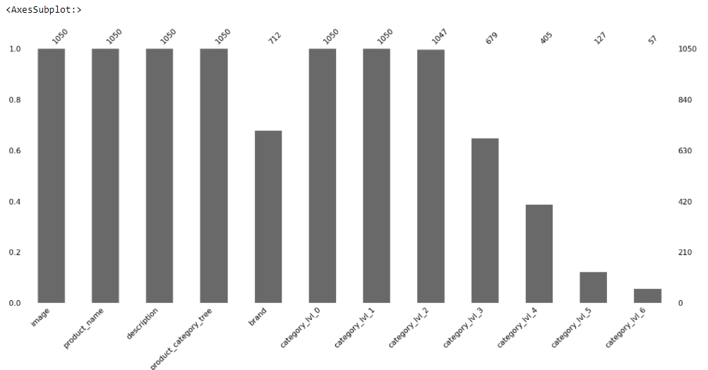
Variable Categorielle
Variable “Product_categoey_tree”
On extrait les valeur des catégories délimitées et on les stock autant que variables. On garde les columns qui detiennes moins de valeur nulles
Data Presentation

Slide 8
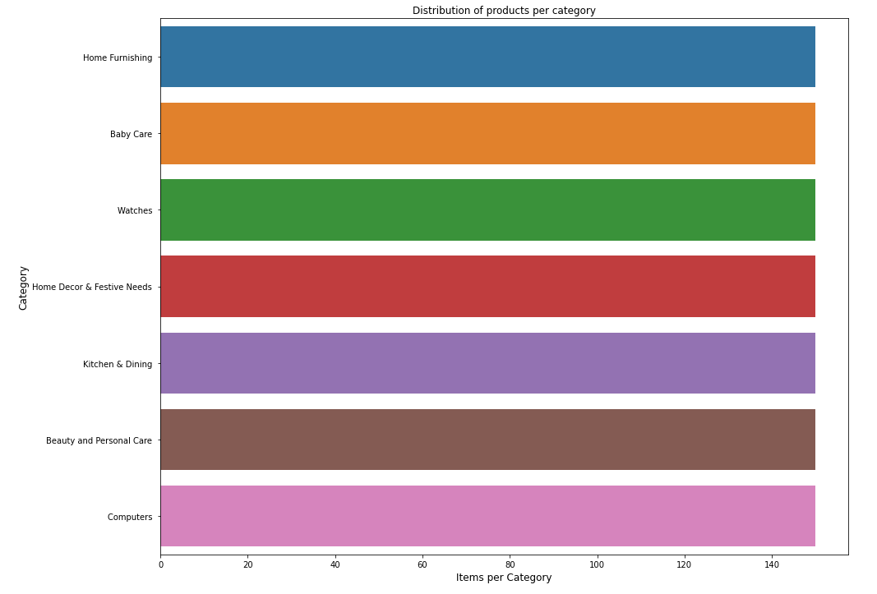
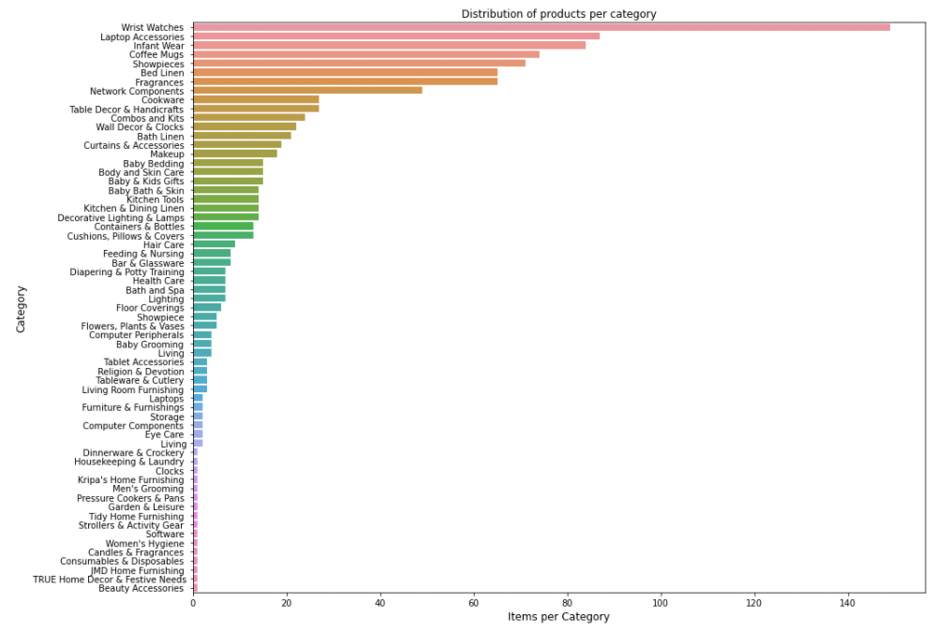
Variable Categorielle
Variable “Product_categoey_tree”
On remarque dans le categorie principal détient 7 categorie et dans le categorie secondaire detient 63 categories.
Data Presentation
On décide de travailler avec le categorie principal , de raison que la categorie secondaire a des des lignes qui detiennes que 1 seul produit et ceuci pourra affecter negativement not Machine learning.

Slide 9
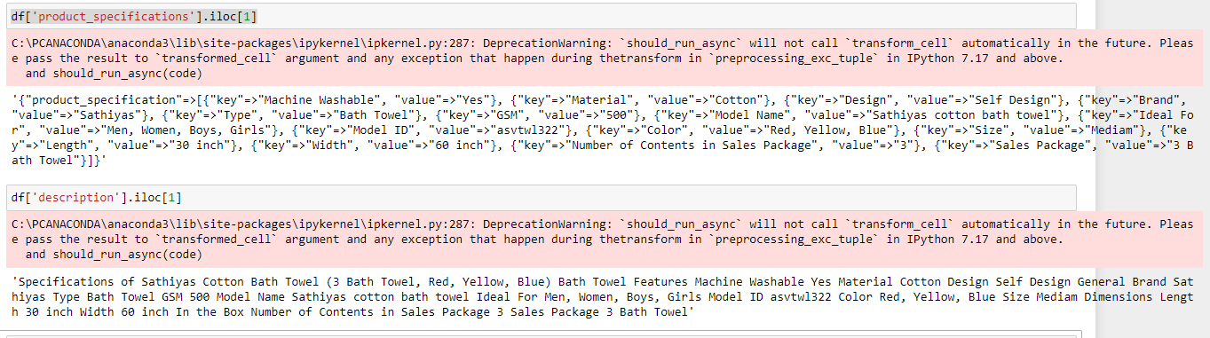
Variable Categorielle
Variable “Product_specification ” and “description”
Data Presentation
We extract the information from “description” and not from “product_specification” because the product_specification is already classified data and easy to predict, unlike the description that the customer will write

Slide 10
Data preprocessing on text
03

Slide 11
Text data processing
Preparation of the corpus
Corpus processing
TFIDF-VECTORIZER
Size reduction
Classification

Slide 12
Preparation of the corpus
Feature engineering / Treatment of columns/Cleaning
Text Data Processing
Dropping columns that we do not need
Remove all columns that has NA
Fill empty brand columns with “ “
Distribution integrale des produits
Combine Brand. Product Name and Description
Treatment of text of column “Description”
Splitting all text from number
Lower case
Remove digits
Remove stop words
Remove unwanted words
Remove single and double characters
Remove special characters
Tokenizing
Lemmanizing
Remove unwanted words

Slide 13
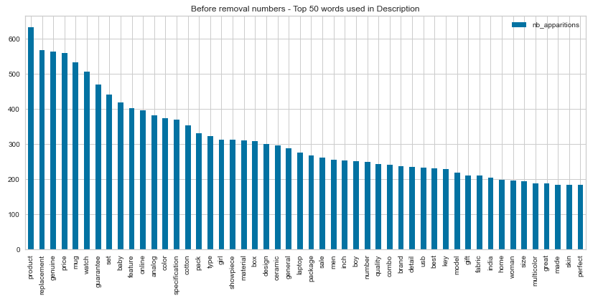
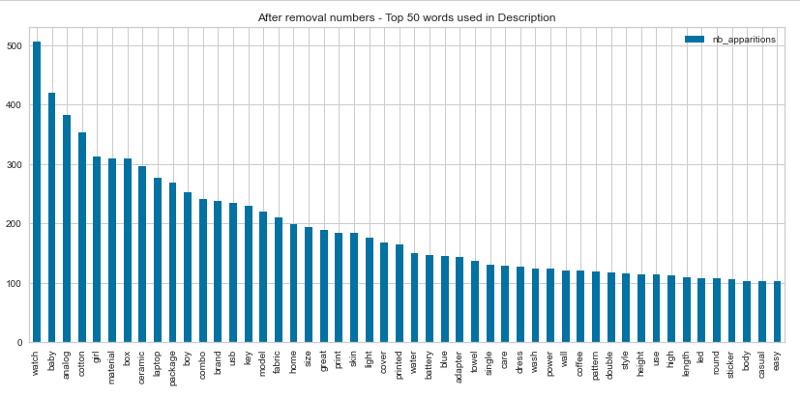
Preparation of the corpus
Feature engineering / Treatment of columns/Cleaning
Text Data Processing
Before and after removing unwanted words

Slide 14
Text data processing
Preparation of the corpus
Corpus processing
TFIDF-VECTORIZER
Size reduction
Classification

Slide 15
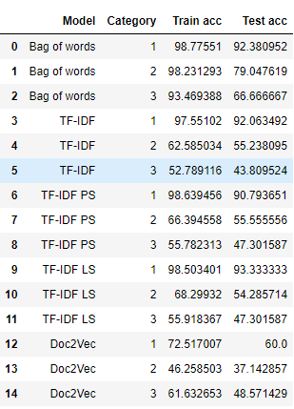
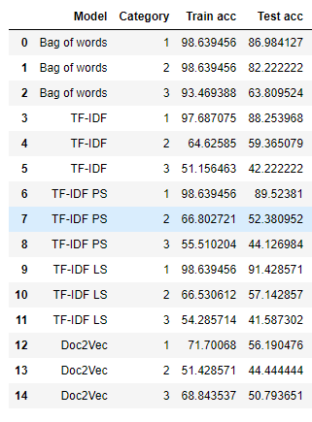
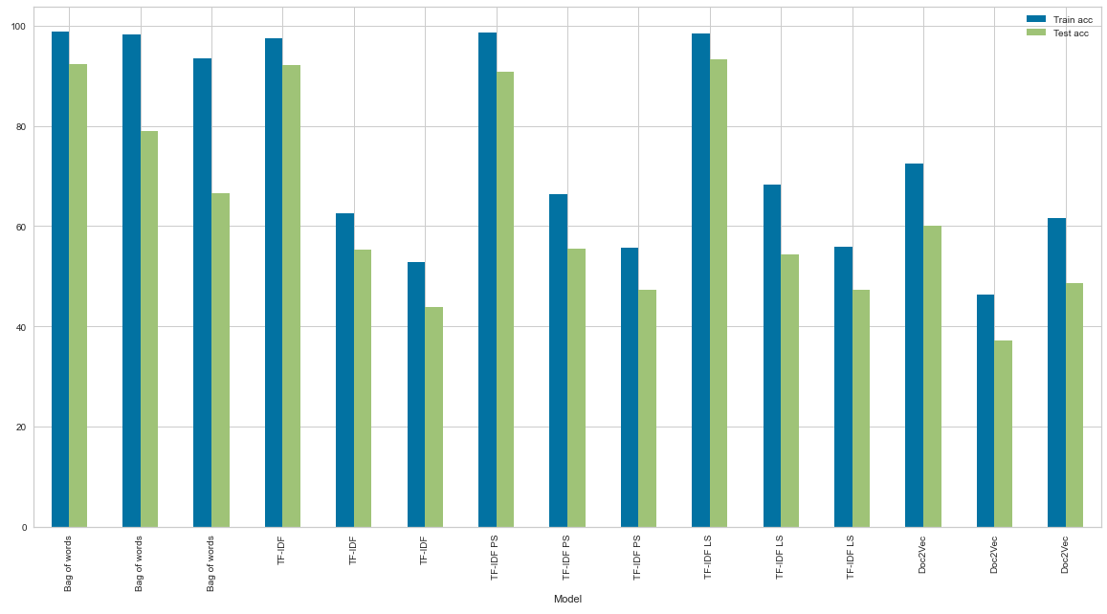
Corpus processing
Text Data Processing
We have run several time the program and we always get some model that over fit. The only one that i see that his over fitting is at it’s minimum is the TF-IDF. I will modelise the data based on it.

Slide 16
Text data processing
Preparation of the corpus
Corpus processing
TFIDF-VECTORIZER
Size reduction
Classification

Slide 17
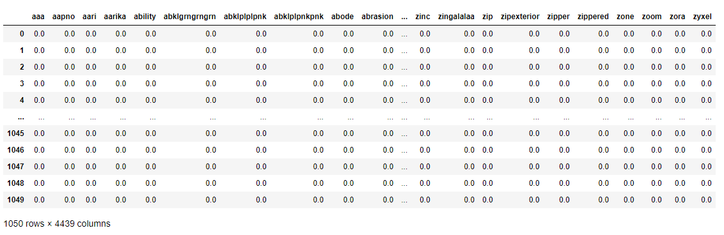
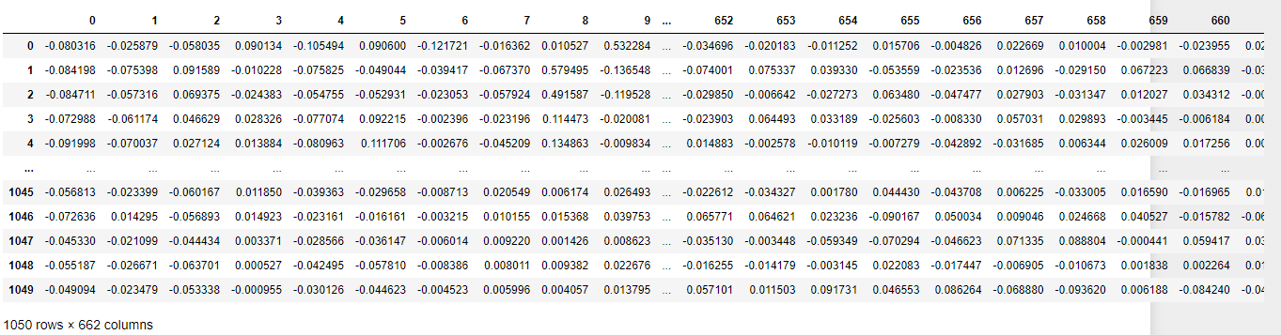
TFIDF-VECTORIZER
Text Data Processing
We are using TFIDF- VECOTRIZER to concert the text into columns similar to ONE-HOT-ENCODER
We gate a shape : (1050, 4439)
Then we use PCA to select the
Columns that are relevant up to 95%
We end up with (1050, 662)

Slide 18
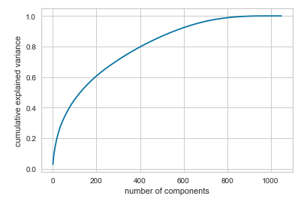
TFIDF-VECTORIZER
Text Data Processing
Vectorized the data with “TfidfVectorizer”
Drop all columns that could affect negatively the PCA
Transform the Data with PCA
Keep 95% that covers the PCA of the valuable data
The dimension started at 1050 rows × 4439 columns
After PCA the dimension arrived at 1050 rows × 662 columns

Slide 19
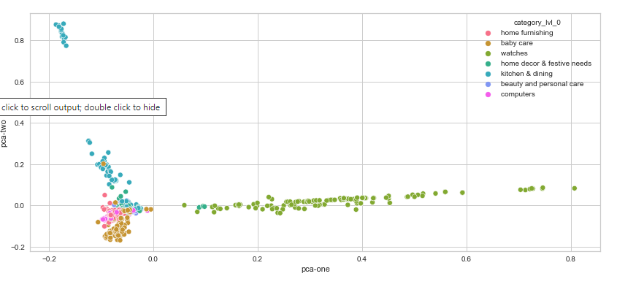
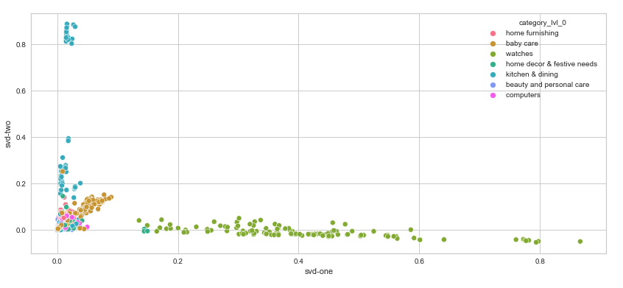
TFIDF-VECTORIZER
Text Data Processing
We test is the PCA or SVD results to see the best value and we decut that the PCA is the best
PCA on TF values
SVD on TF values
Number of dimensions: 2
Cumulative explained variances: 0.05
Number of dimensions: 2
Cumulative explained variances: 0.04

Slide 20
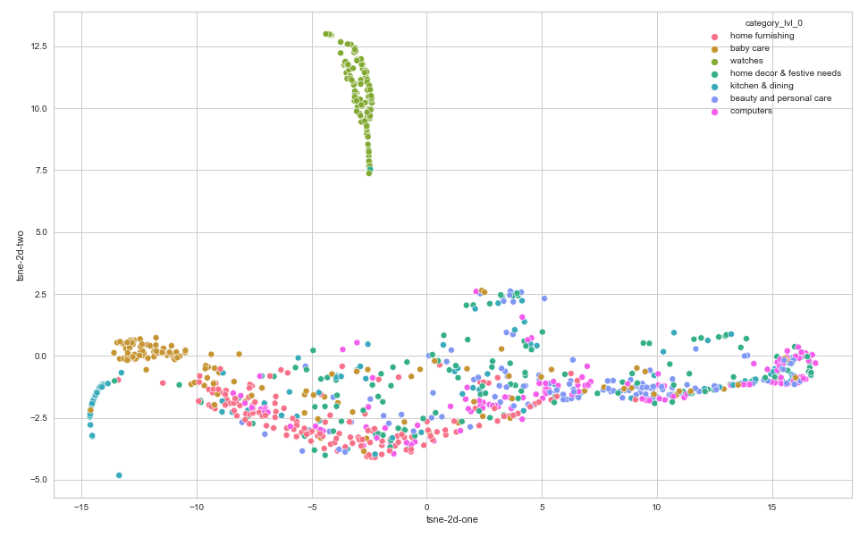
TFIDF-VECTORIZER
Text Data Processing
We use TSNE on the PCA value and we do see that a clear group was formed with the watches but not the rest with a perplexity of 128

Slide 21
Text data processing
Preparation of the corpus
Corpus processing
TFIDF-VECTORIZER
Size reduction
Classification

Slide 22
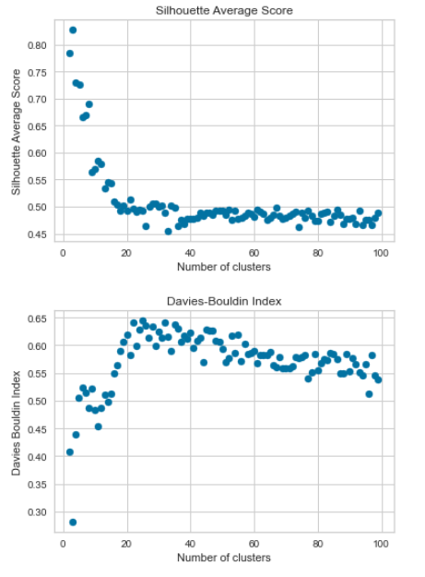
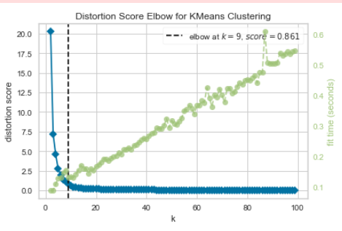
Kmeans for SVD
Text Data Processing

Slide 23
Text data processing
Preparation of the corpus
Corpus processing
TFIDF-VECTORIZER
Size reduction
Classification

Slide 24
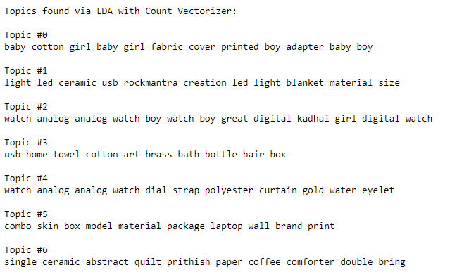
LDA topic modeling
Data Presentation

Slide 25
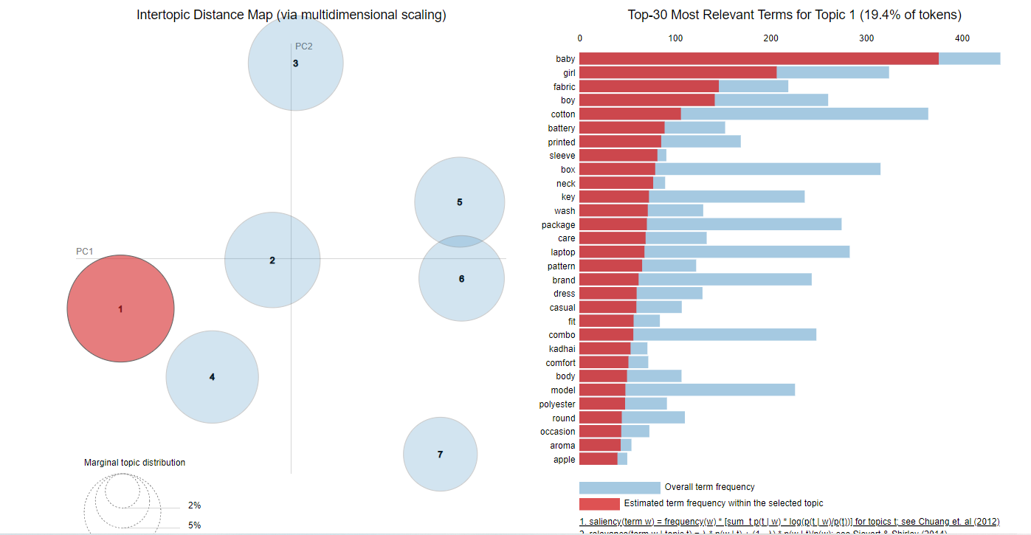
Corpus processing
Text Data Processing

Slide 26
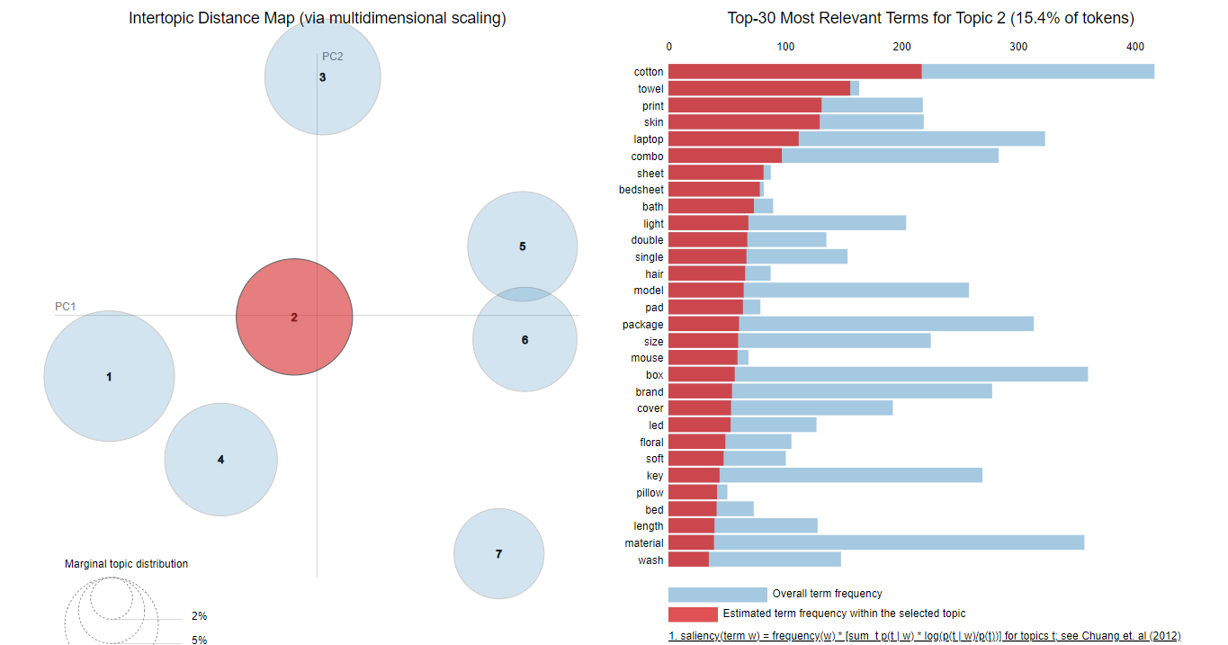
Corpus processing
Text Data Processing

Slide 27
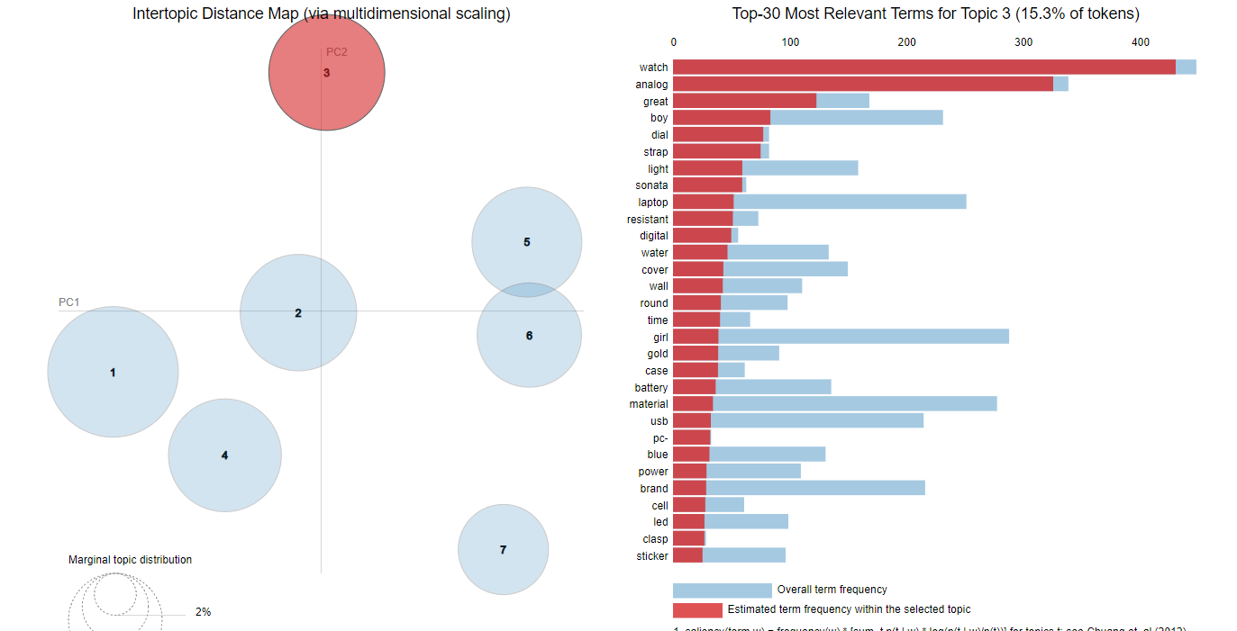
Corpus processing
Text Data Processing

Slide 28
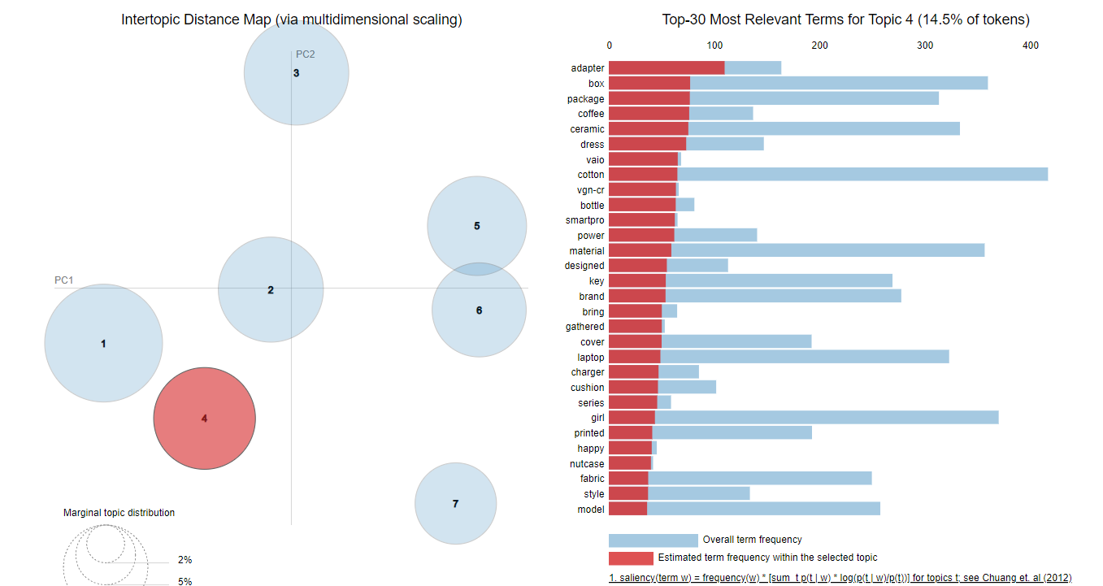
Corpus processing
Text Data Processing

Slide 29
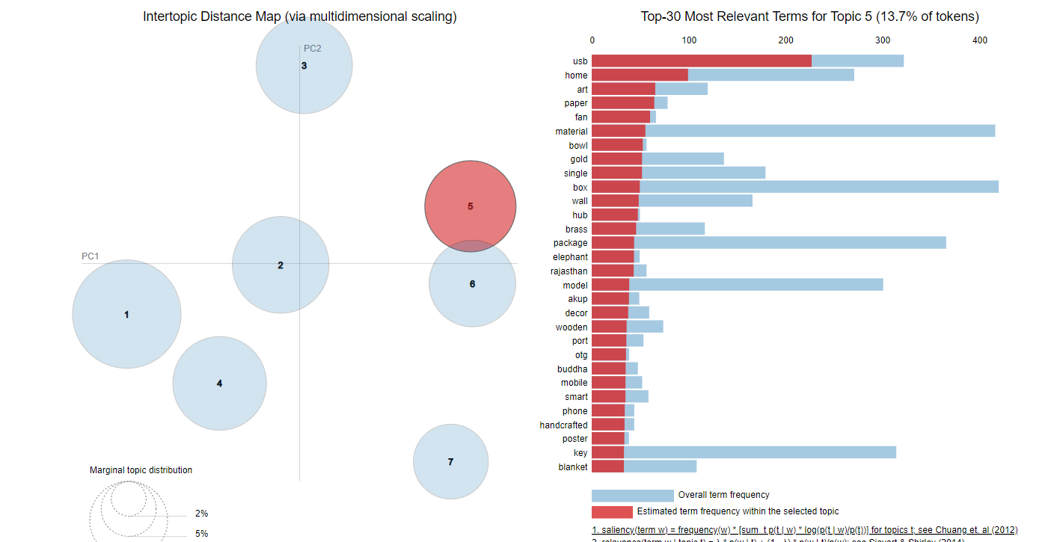
Corpus processing
Text Data Processing

Slide 30
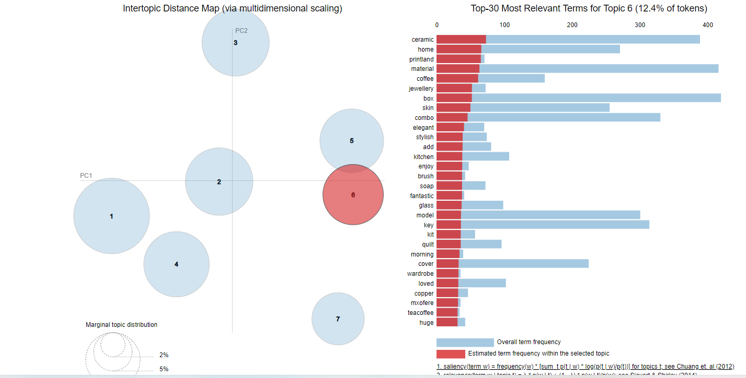
Corpus processing
Text Data Processing

Slide 31
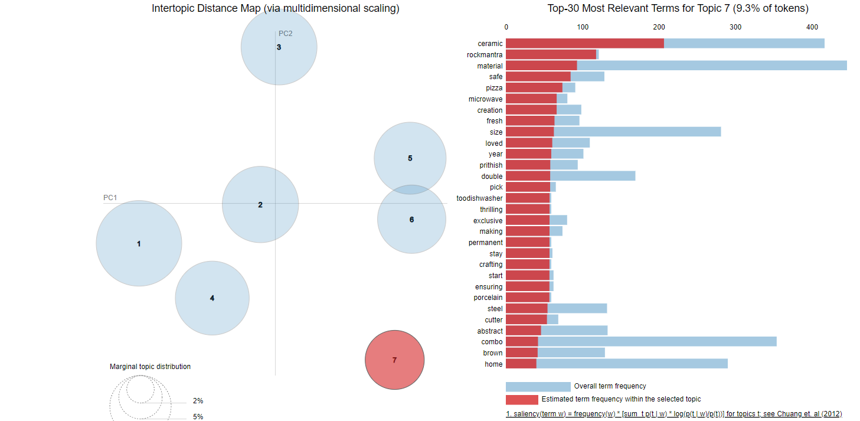
Corpus processing
Text Data Processing

Slide 32
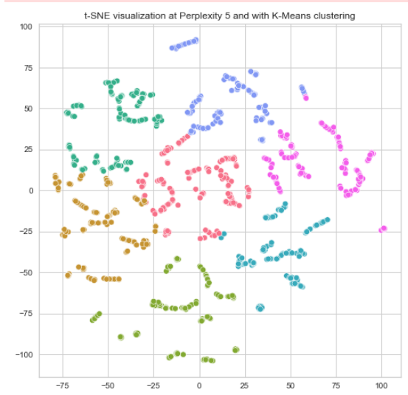
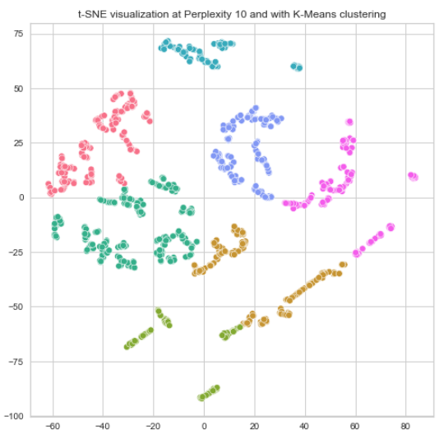
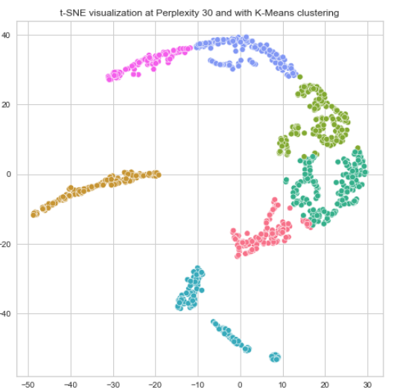
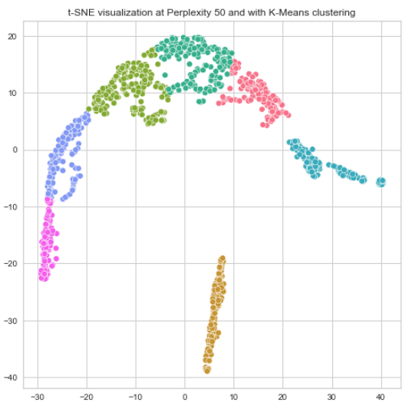
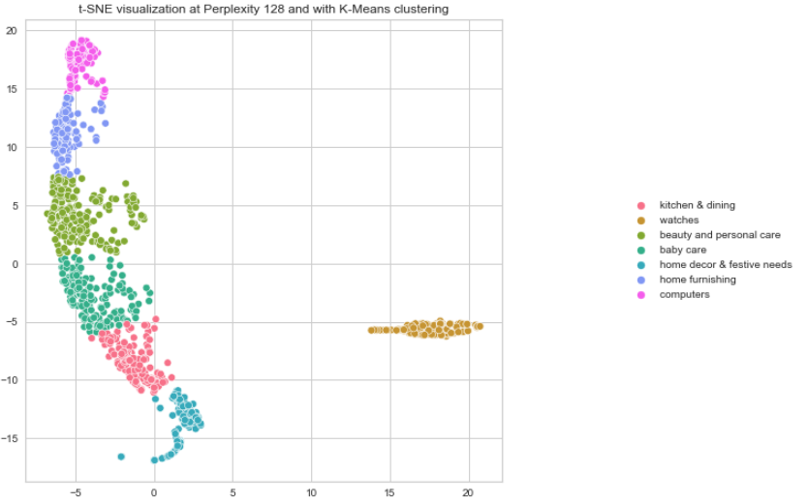
TSNE with Kmeans and SVD
Data Presentation

Slide 33
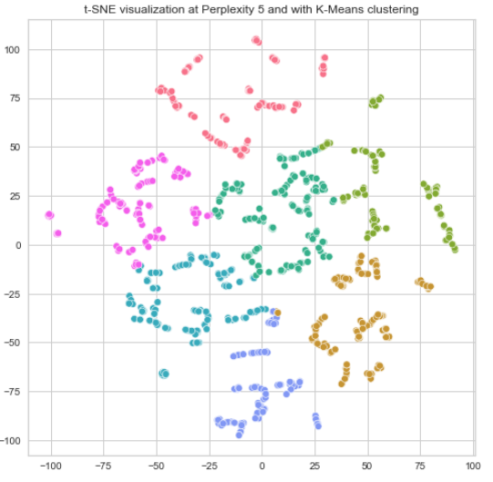
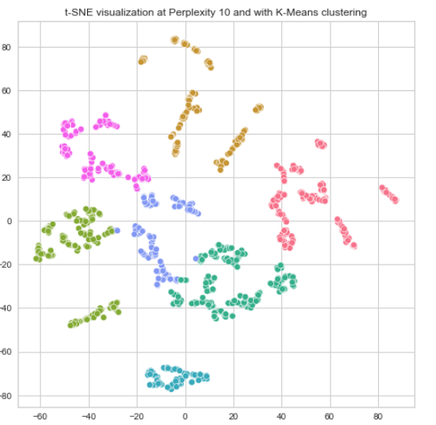
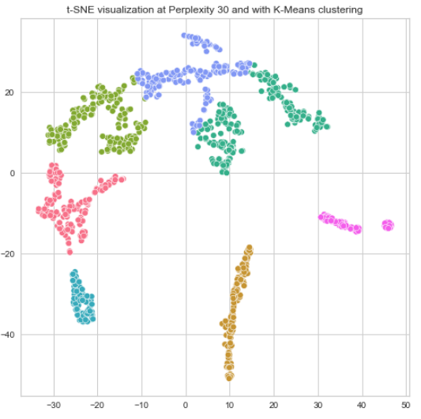
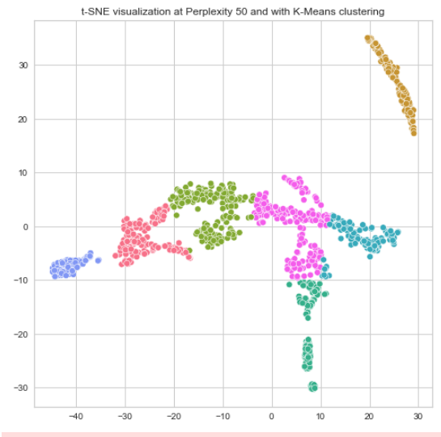
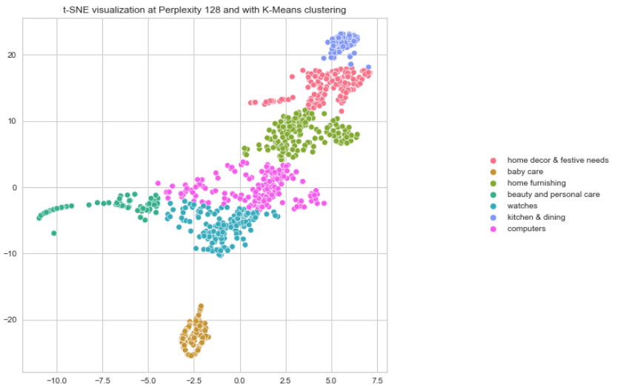
TSNE with Kmeans and PCA
Data Presentation

Slide 34
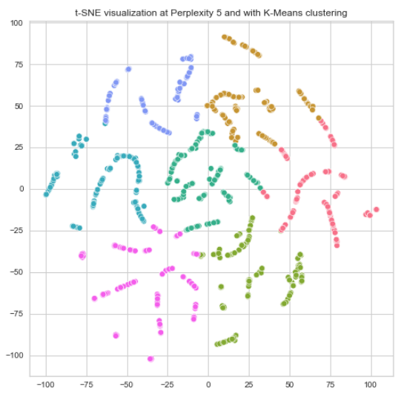
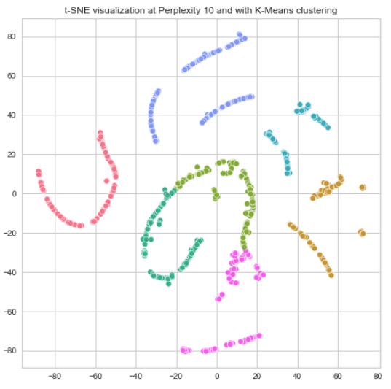
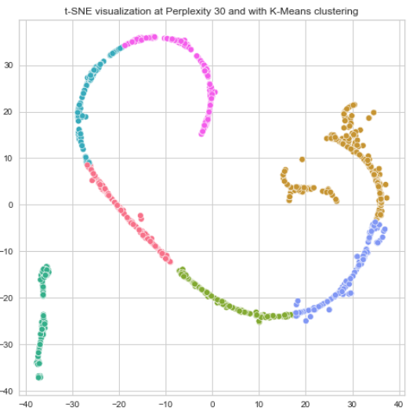
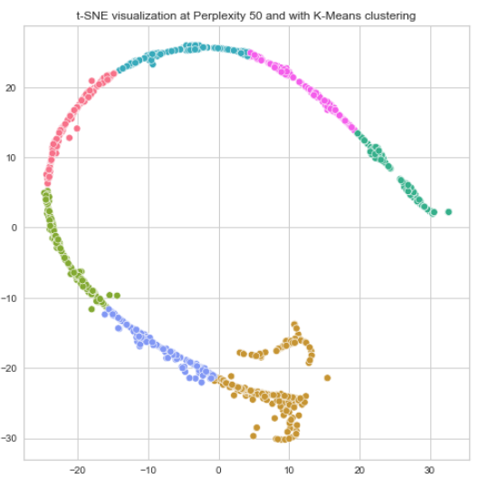
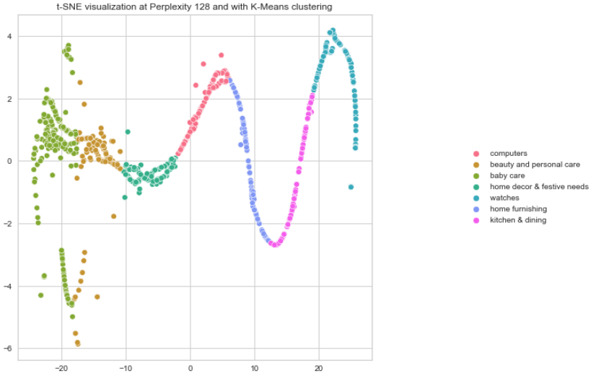
TSNE with Kmeans and KPCA
Data Presentation

Slide 35
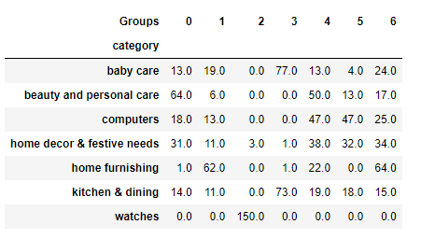
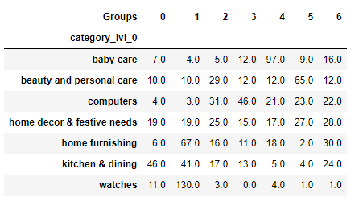
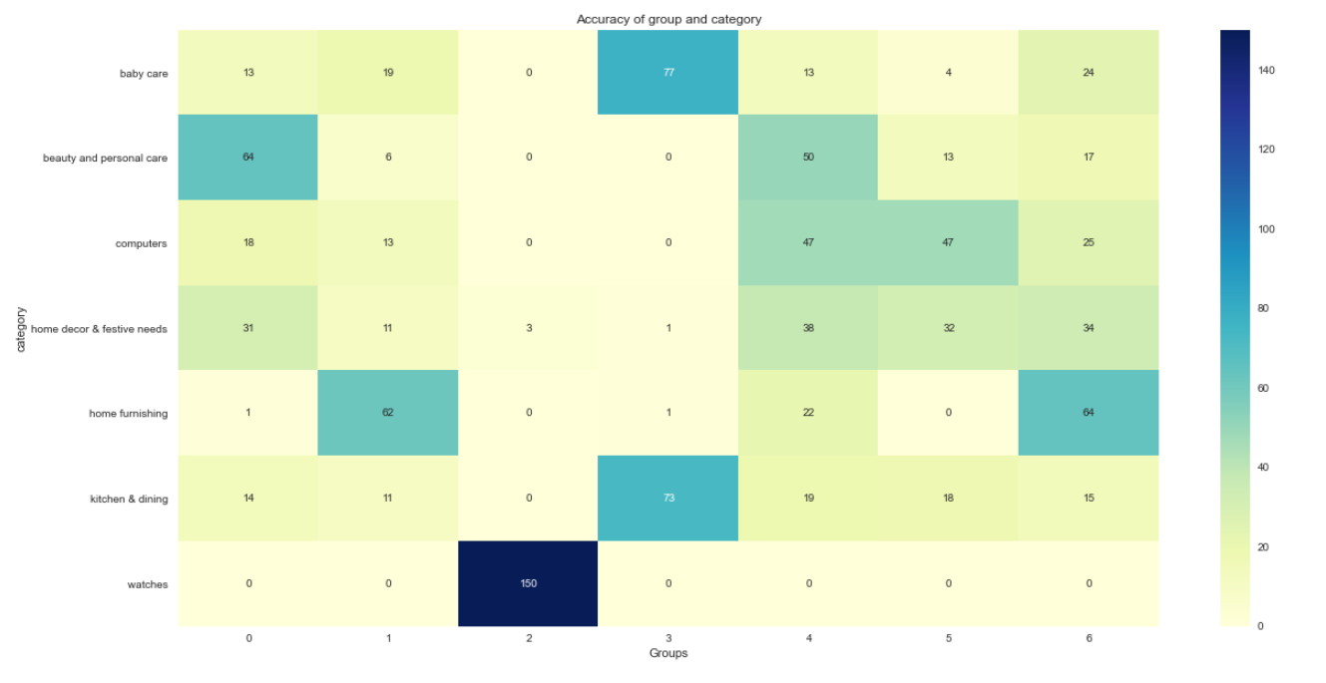
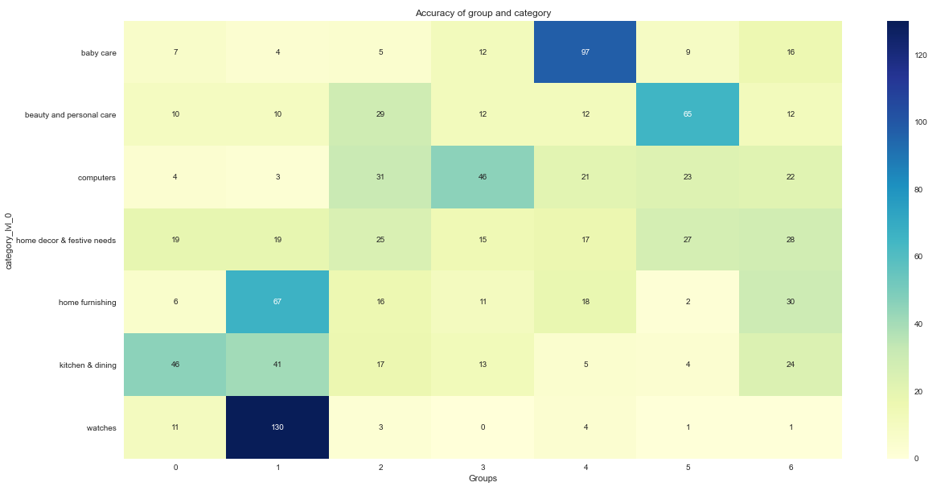
Rand index
Data Presentation
LDA model
ARI for LDA: 0.17911726989707108
Kmeans model
ARI for kmeans: 0.2806559406083021

Slide 36
image processing
Pretreatment
determination of explanatory variables
Classification
convolutional neural network
CNN
Keras VGG16
Plan

Slide 37
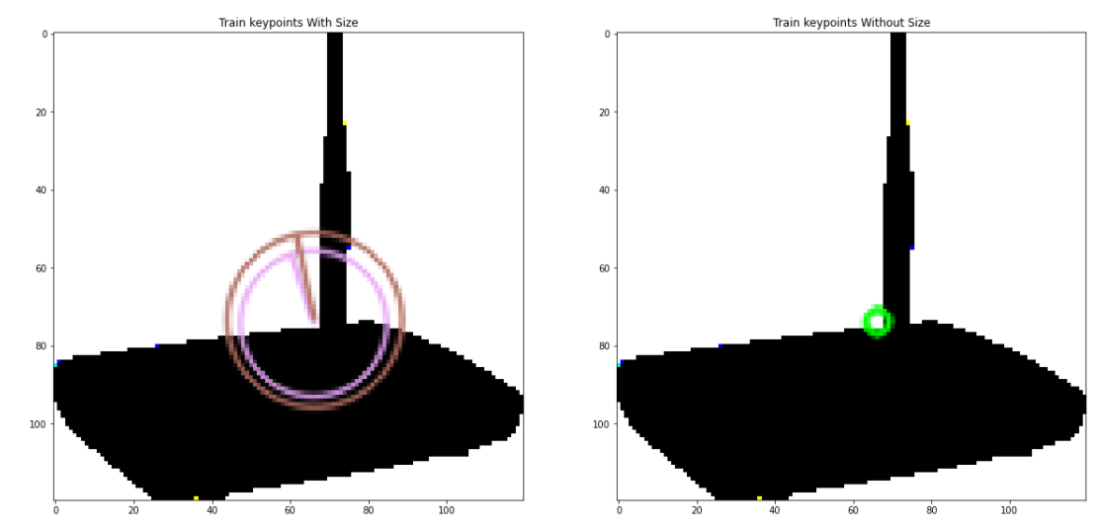
TSNE with Kmeans and KPCA
Data Presentation

Slide 38
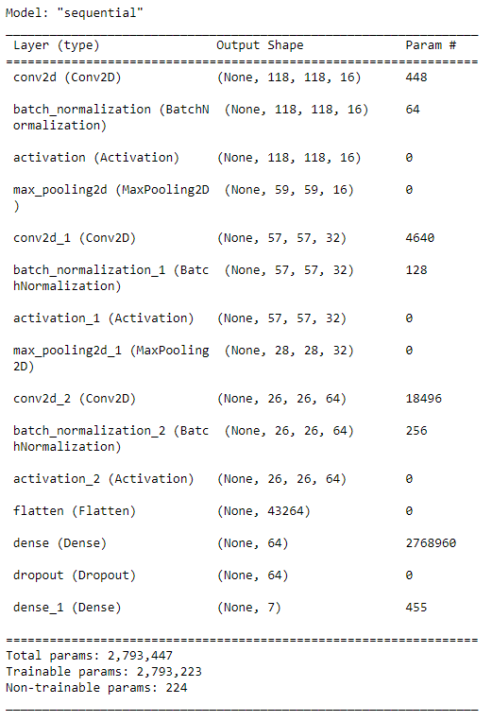
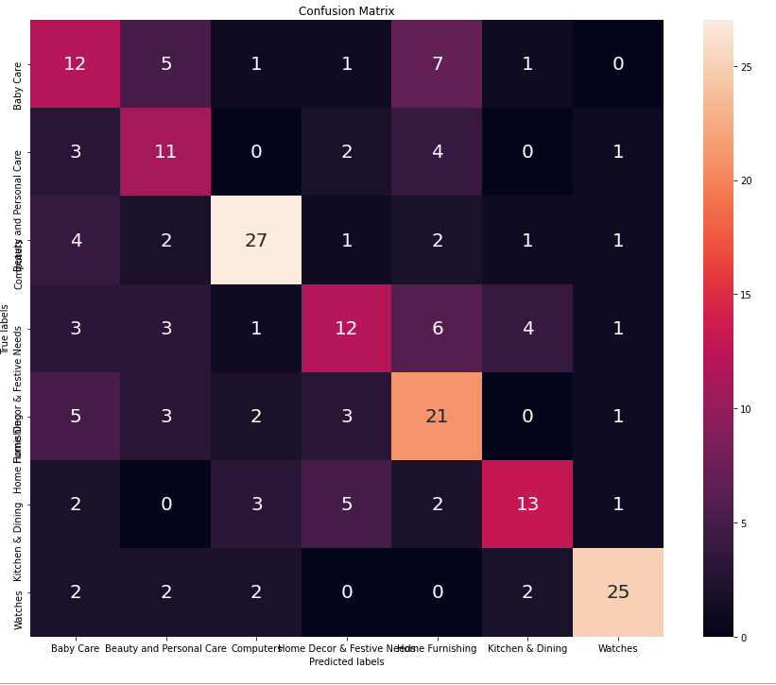
ARI for CNN
Data Presentation
Accuracy: 0.5473684072494507

Slide 39


ARI for VGG16
Data Presentation
Accuracy : 0.784211

Slide 40


Kmeans 7 clusters based on images
Data Presentation
Silhouette Score for 7 cluster :0.3110476150221834
ADD details of line 60- to 75

Slide 41


Kmeans 7 clusters based on images
Data Presentation
Kmeans on PCA
Kmeans on SVD
Kmeans on KPCA

Slide 42





Tsne with SVD
Data Presentation

Slide 43





Tsne with PCA
Data Presentation

Slide 44





Tsne with KPCA
Data Presentation

Slide 45

Prediction with SVD Kmeans with perplexity=30
Data Presentation

Slide 46

Prediction with PCA Kmeans with perplexity=30
Data Presentation

Slide 47

Prediction with KPCA Kmeans with perplexity=30
Data Presentation

Slide 48
Conclusion
08

Slide 49
Get more observations
Get more variables (minimize missing values)
Filing plan
Review category structures more categories
Pretreatments
Specific tests to identify the optimal methods
Methods
Tests and optimizations
Recommendations
Texts: TFIDF
Images: VGG16

Slide 50
END
Notes:
Hyper parameter of all model

